Slide 1
ARNES – Registry for .si
Barbara Povše Golob, Head of .si Registry
barbara.povse@arnes.si Ljubljana, 7.9.09

Slide 2
ARNES – Academic and Research Network
ARNES = Academic and Research Network of Slovenia
public institut
provides network services for research, educational and cultural organizations
40 staff
international cooperation and projects: TERENA, DANTE, CEENet, FIRST, RIPE, ENISA, SAFE…

Slide 3
ARNES – Registry for .si
.si registry is a (small) part of ARNES
first domain under .si in 1992 (.yu before)
3,6 FTE employed by the registry
founding member of CENTR (Council of European National TLD Registries) – www.centr.org
member of ICANN ccNSO since February 2009
advisor to Slovene representative in ICANN GAC (Governmental Advisory Committee)
Member of EURid BoD
.si is “safe” (McAfee study 07, 08)

Slide 4
.si policy changes
Strict
.si 1992
.si 1999
Less
Strictly regulated
Bureaucracy
Requirements for applicant
Freedom of choice Potential for conflict
Regulated by quota
.si 2004
Unregulated
Weak
.si 6.11.2008
More
Limited
Number of domain names
Unlimited

Slide 5
.si until 4.4.2005
“closed” registry
only legal entities from Slovenia entitled to register under .si
domain name = registered name or trade mark
direct registration
(no registry-registrar system)
free of charge
no automated procedures in place

Slide 6
.si from 4.4.2005 until 6.11.2008
new policy
only legal entities from Slovenia entitled to register
up to 20 domain names per holder
registry-registrar system
client&server developed by Arnes
based on EPP, adjusted by extensions
no direct registration
(for organizations, connected to ARNES up to 2 free domain names)
registration and annual fee introduced
ADRP – Alternative Dispute Resolution Policy

Slide 7
Registry-registrar system
requirements for registrars
legal entity established in Slovenia
domain name under .si and active home page
“technical ability to communicate with Arnes server” (test)
registrar is acting on behalf of domain name holder but for its own account
prepayment system
cca. 110 registrars

Slide 8
ADRP – Alternative Dispute Resolution Procedure
independent arbiters, ARNES only administrative role
three conditions must be fulfilled to commence the ADR procedure:
the domain name has to be the same or closely similar to a registered trademark
domain name holder does not have the right to his registered domain name
the domain name is registered or used in ill faith
all decisions published
27 disputes in 4,5 years

Slide 9
New rules on 6.11.2008
local presence not requiered (for holders)
natural persons eligible
no limitation on maximum number of domain names per holder;
registration period can be chosen from 1 up to 5 years;
numeric domains have been allowed.

Slide 10
Some statistics - registrations

Slide 11
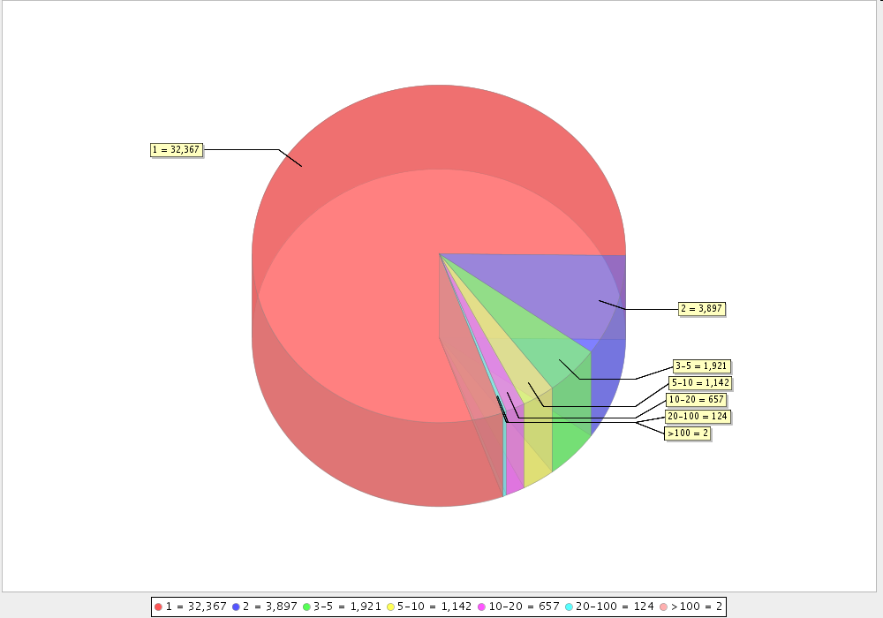
Some statistics – domain names/holder

Slide 12
Some statistics – domain names/registrar

Slide 13
Arnes relationship with registrars
1- 2 physical meetings per year
introducing proposed changes, asking for input, discussion
management tool for registrars (functions, which are not included in EPP protocol)
administrative and technical support via e-mail and phone
“We _do_ care” approach & low requirements for registrars mean a lot of Arnes resources are spent on registrar support

Slide 14
Arnes relationship with domain name holders
“Contractual legal relations between Arnes and a Domain name holder shall arise at the moment a Domain name is registered.” (GT&C)
direct communication with the domain name holder in case of (confirmation via web interface):
delete request
change of registrar
change of domain name holder
still a lot of communication with holders via e-mail and by phone (historical reasons)

Slide 15
Future plans
Change of database (MySQL to DB2)
Update of server to standard EPP
Anycast service (running from march 2009)
DNSmon (running from june 2009)
Promotion campaign of .si
DNSSec

Slide 16
Thanks!
barbara.povse@arnes.si
http://www.arnes.si/english/domains.html

